Slide 1
COURSE PROJECT
DESIGN AND IMPLEMTATION OF DIGITAL SYSTEM FOR LOTTERY NUMBER GENERATOR
SNEHA G HIREHOLI – 01FE20BEC209
RAHUL R CHHEDA – 01FE20BEC210
AMRUTA MEHARWADE – 01FE20BEC212
VEERESH PATTAR – 01FE20BEC211

Slide 2
INTRODUCTION:
Lottery generator is an application of random number generator.
An random number is generated on 7 segment display which is considered as lottery number.
It can be used in wide application like for picking up lucky draw, housie.

Slide 3
PARTS USED:
Timer/Clock (IC 555)
Decade Counter (IC 4026)
Common Anode 7 segment display
Resistors – 1k (2)
Capacitors – 47uF
Single stranded wire
Breadboard
NOT gate (IC 7404)
Push Button-1

Slide 4
BLOCK DIAGRAM:
FREQUENCY IS GENERATED BY CLOCK
PUSH BUTTON
FREQUENCY FED TO IC 4026
COUNT STARTS FROM 0 T0 99
PUSH BUTTON IS RELEASED
DISPLAY OF A RANDOM NUMBER

Slide 5
HOW IT WORKS:
In this circuit 555 timer is wired as astable multivibrator where it generates square waves to feed the IC 4026. The frequency of this square wave depends upon the value of R1,R2 and C1. The formula to determine the output frequency is f = 1.44 / ( R2 + 2R1 ) C1 which gives a square wave of frequency 480hz as output.
You should keep the frequency output high so that the user will cannot judge the number sequence by any means. A button is placed in way of this signal which is feed to the IC 4026 when button is pressed. IC 4026 is a 7 segment decoder which takes clock signal input. The IC counts from 0 to 9 with each individual clock pulse and resets back to 0 once it hits 9. This cycle repeats itself with the incoming clock signal. The chip also decodes these counted values of 0 to 9 and lights up the 7 segment accordingly.
Since the speed of the clock signal is too fast the IC will count from 0 to 9 almost 48 times ( due to 480 hertz clock signal ) in a matter of second. This makes the number appears in the 7 segment to be random and unpredictable in nature.

Slide 6
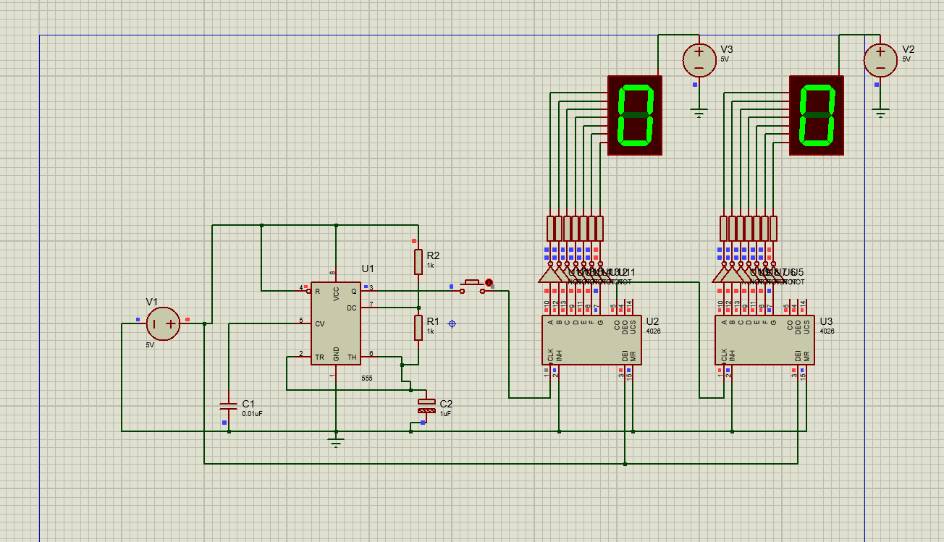
CIRCUIT DESIGN:

Slide 7
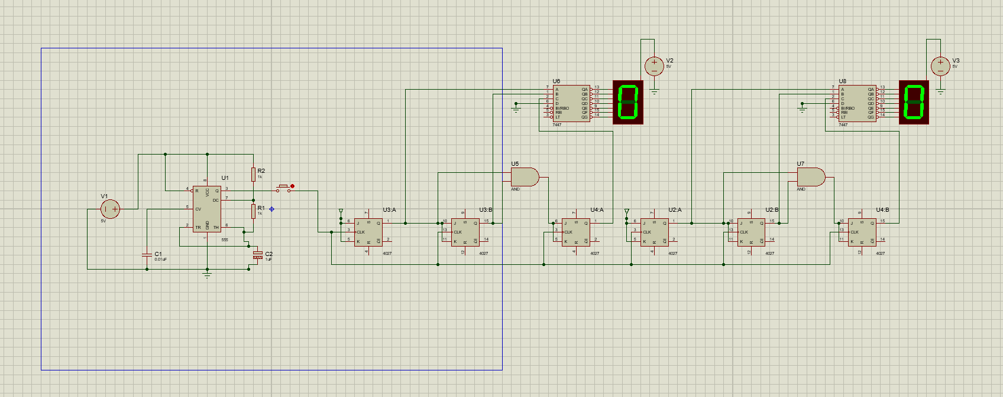
ALTERNATE CIRCUIT DESIGN:

Slide 8
DECISION MATRIX:
 | COST (WEIGHT=05) | COMPLEXITY (WEIGHT=03) | AVAILIBILTY (WEIGHT=04) | SCORE
DESIGN 1 | 05*05=25 | 05*03=15 | 05*04=20 | 60
DESIGN 2 | 02*05=10 | 04*03=12 | 03*04=12 | 34
Since the score of Design 1 is high compared to Design 2, we prefer Design 1 over Design 2. Hence, we select Design 1 as our Final Design.

Slide 9
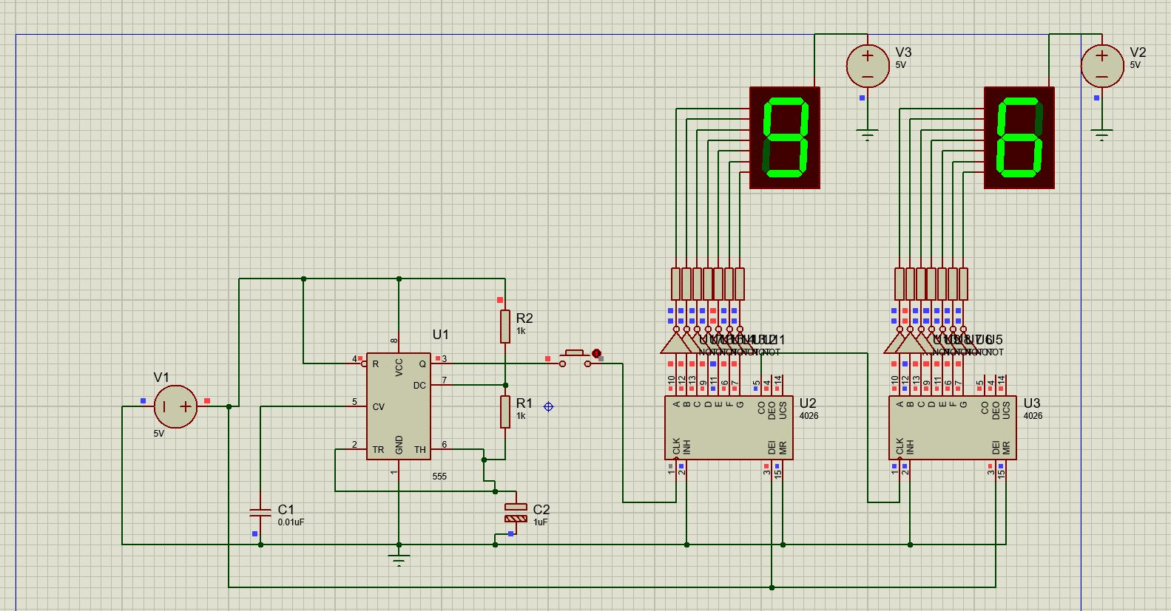
SIMULATION:

Slide 10
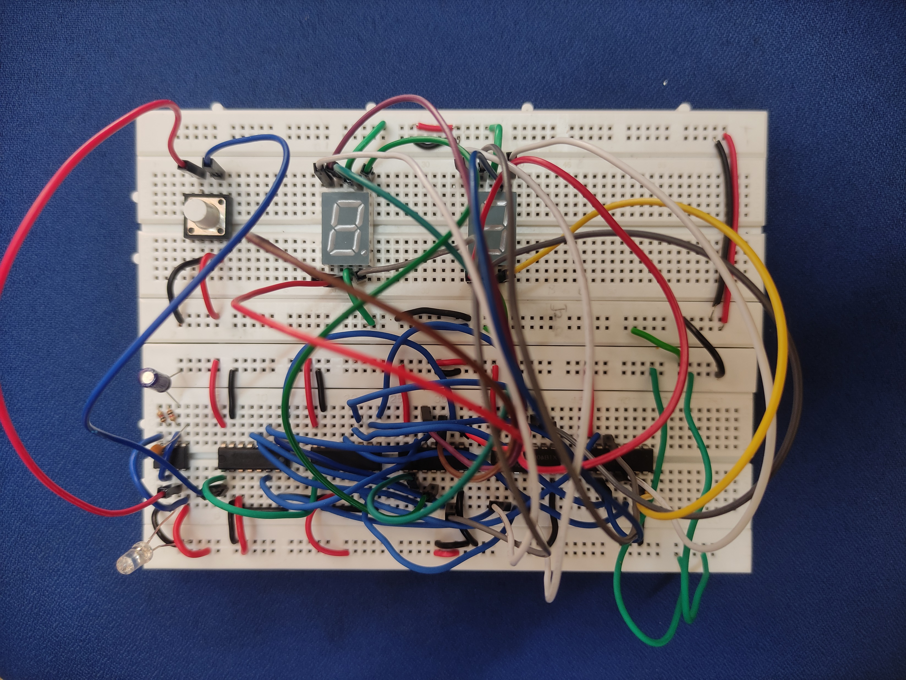
IMPLEMENTATION:

Slide 11
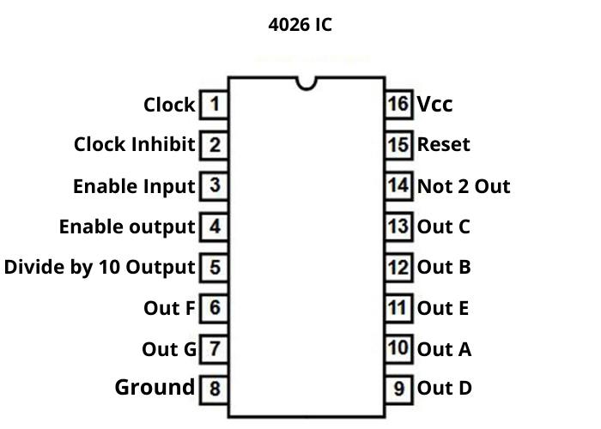
PIN DIAGRAM :
Pin Diagram of 4026 IC

Slide 12
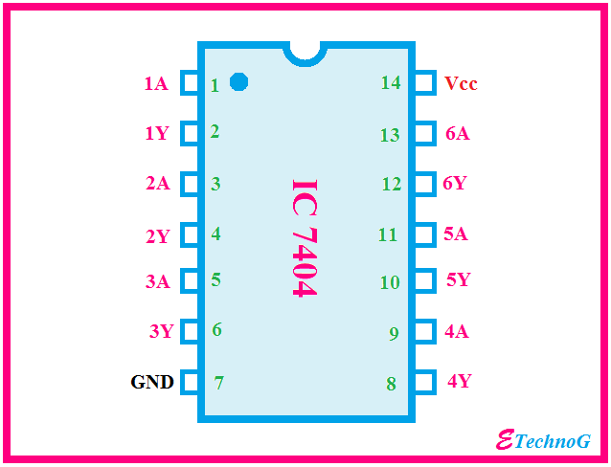
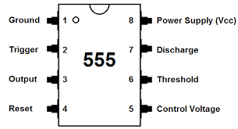
PIN DIAGRAM :
Pin Diagram of 7404 IC
Pin Diagram of 555 IC

Slide 13
RESULT AND CONCLUSION:
In this circuit the user is given a push button SW1 where it needs to be pressed for the number sequence to start. The number count goes from 0 to 99. When the button is pressed the circuit will increment the sequence at high speed and upon the release of this button you will have your random number.
In this circuit, we have used 4026 decade counter and designed a random number generator, this circuit provides us a 2 digit random number as a result.

